Slide 1
Achievements Under the Five Broad Modules of the GCLME Project Combating Living Resource Depletion and Coastal Area Degradation in the Guinea Current LME Through Ecosystem-Based Regional Actions
by Dr. Jacques ABE Environment Scientist
j.abe@unido.org
Website: www.igcc.gclme.org

Slide 2
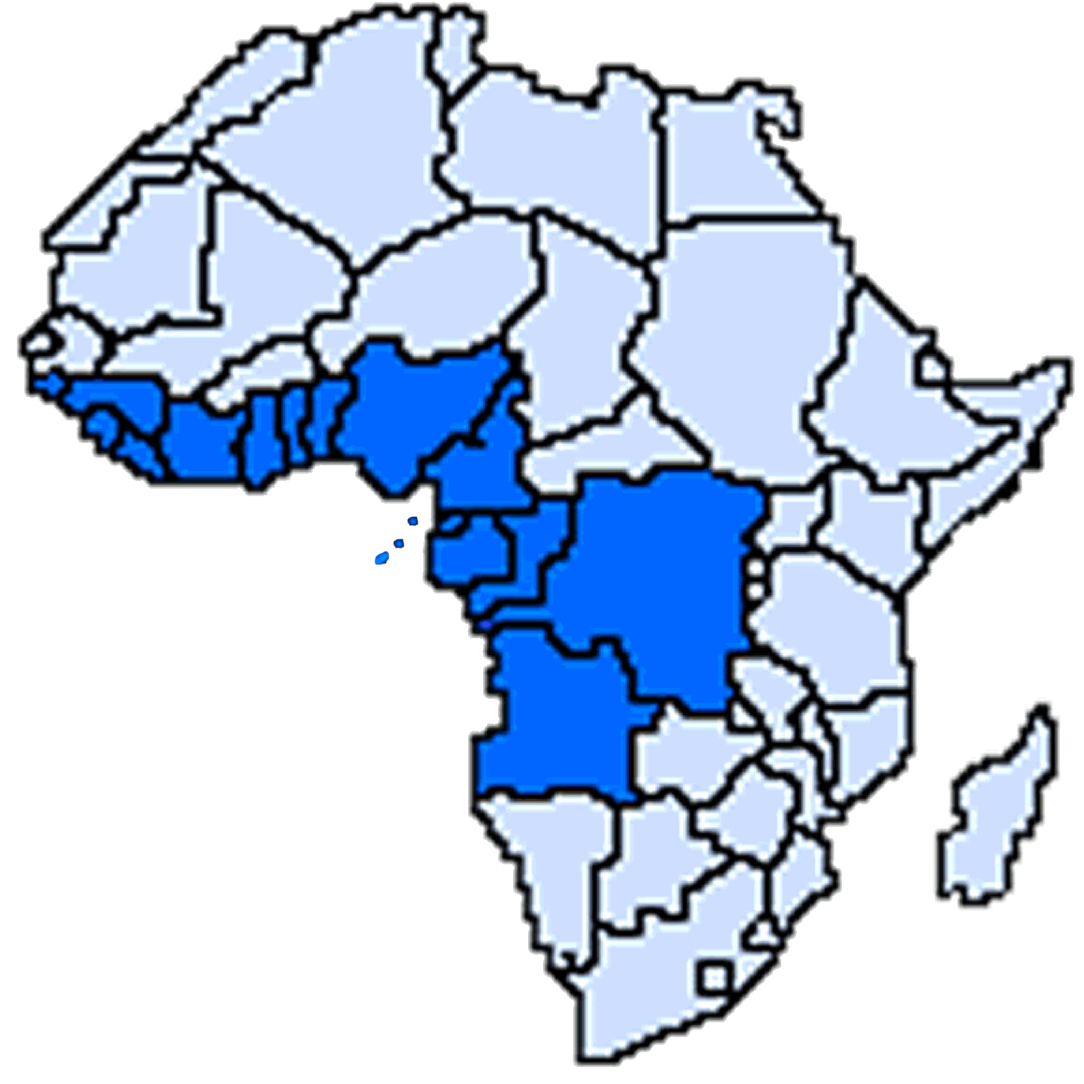
16 Project Countries:
(1) ANGOLA,
(2) BENIN,
(3) CAMEROON,
(4) CONGO,
GUINEA
G
H
A
N
A
T
O
G
O
B
E
N
I
N
C
A
M
E
R
O
O
N
(5) CONGO D.R,
GUINEA BISSAU
CÔTE
D’IVOIRE
NIGERIA
(6) COTE D’IVOIRE,
SIERRA LEONE
(7) EQUATORIAL GUINEA,
LIBERIA
C
O
N
G
O
(8) GABON,
SAO TOME AND
PRINCIPE
GABON
D.R. CONGO
(9) GHANA,
EquatorialGUINEA
(10) GUINEA,
(11) GUINEA- BISSAU ,
ANGOLA
(12) LIBERIA,
(13) NIGERIA,
(14) SAO TOME AND PRINCIPE,
(15) SIERRA LEONE,
(16) TOGO.

Slide 3
GCLME PROGRAMME
Main Project Objectives
The overall development goals of this project are to:
Recover depleted fish stocks,
Restore degraded habitat,
Reduce land and ship-based pollution, and
Create an ecosystem-wide assessment and management framework for sustainable use of living and non-living resources in the GCLME.
Establish viable regional consultative and coordination mechanisms for joint actions in transboundary management of the GCLME including a Guinea Current Commission

Slide 4
GCLME PROGRAMME
The GCLME Project has made real progress and successfully completed many of the activities set out to achieve during this phase of the GCLME Programme:
The Transboundary Diagnostic Analysis (TDA) is one of these achievements.
As a result of this TDA, a Strategic Action Programme (SAP), and the associated National Action Plans (NAP) have been prepared and endorsed (or are in the process).
The present GCLME Project has also established the regional and national management framework Guinea Current Commission (Interim) and has began the process of partially implementing aspects of the SAP (demonstrations projects etc).
The next phase of the GCLME Programme will be the full implementation of the SAP/NAP.

Slide 5
GCLME PROGRAMME
Project Strategy
Develop and apply an effective regional approach to:
Create improved legal/management frameworks and institutional structures to address priority regional issues, including a Guinea Current Commission, a Regional Fisheries Sub-Commission, and other regional and national bodies for conducting effective regional interventions for rational fisheries utilization, biodiversity conservation, pollution prevention and coastal erosion defence.
Successfully implement nine (six national and three regional) demonstration projects to serve as a basis for replication in the region and outside the region, as concrete steps towards achieving agreed environmental quality objectives.
Develop nationally endorsed Strategic Action Program and National Action Plans (NAPs) with accompanying sustainable financing plan to lead the way towards continued incremental improvement to the GCLME based on a solid foundation of regional commitment and consensus.

Slide 6
GCLME PROGRAMME
Assessment of Project Performance and Achievement of Targets

Slide 7
GCLME PROGRAMME
D1- Recover Depleted Fish Stocks
with the advent of the project, the region wide fish trawl and productivity surveys (with FAO/ IMR Norway) in 2005, 2006 and 2007 combined with historical information are providing invaluable insights to the extent of fishery depletion, the carrying capacity of the ecosystem and on maximum sustainable yields as well as on undesirable shifts in biological diversity, etc.

Slide 8
GCLME PROGRAMME
Through these activities and similar initiatives some decisions were taken at regional consultations convened under the aegis of the Regional Coordination Unit of the GCLME/Interim Guinea Current Commission led to:
Restrict the licensing of fishing vessels except for those targeting Tuna resources considered to be still underexploited
Enhancing Monitoring, Control and Surveillance (MCS) measures at national levels while moving to centralised MCS system and measures
Substitute communal for individual country negotiations in respect of Fishery Access Agreements with external partners (both bilateral and multilateral)
Prepare/Update Fishery Management Plans and harmonise fishery/legislation for the 16 countries
Introduce adaptive technologies for aquaculture/mariculture development for supplementary fish production
Discuss the linkages of the (I)GCC with regional fisheries commissions.

Slide 9
GCLME PROGRAMME
D-2 Restore degraded Habitats
The project has undertaken a comprehensive inventory of degraded habitats and a Regional GIS Map (PADHs Hotspots) illustrating the extent and seriousness of the problem is nearing completion at the Regional Environmental Information Management and Decision Support Centre at the University of Lagos, Nigeria. A comprehensive report on Physical Alteration and Destruction of Habitats PADHs document in the GCLME region has been prepared.

Slide 10
GCLME PROGRAMME
Following a review of National Biodiversity Action Plans, a draft ecosystem-wide Biodiversity Action Plan has been proposed and endorsed at a Regional workshop in February, 2007. In Nigeria, the largest stands of mangrove forests have been declared, through legislation, as a Reserve. A National Demonstration Project will demonstrate Best Environmental Practice for the conjunctive use of Nipa palms and the restoration of native mangroves. Cameroon and Angola are set to follow this example while Benin has delineated areas to be designated as Marine Protected Areas.

Slide 11
GCLME PROGRAMME
Changes in regional littoral sediment budgets have been reviewed at Regional Consultations as a way of understanding the prevalent erosion menace. The environmental and social impacts of low cost – low technology coastal defence measures proposed for Cote d’Ivoire are being assessed through a demonstration project and tested through mathematical models at the Centre for Remote Sensing of the University of Cocody, Cote d’Ivoire.

Slide 12
GCLME PROGRAMME
The countries have agreed to the use of Integrated Coastal Area Management (ICAM) for habitat protection and sustainable use of coastal zones. In this regard, the ten “new” countries have completed their coastal profiles and along with the six “Pilot Phase” countries are making progress towards the development of practical Integrated Coastal Management Plans that would bring orderly and integrated development to coastal areas.
A demonstration project in Cameroon will show the benefits from the practical application of an ICAM approach for the management of coastal zones in the Kribi-Campo area.

Slide 13
GCLME PROGRAMME
D-3 Reduce land and Ship-based pollution
The deterioration of the coastal and marine environment is provoked and exacerbated by pollutants from shipping related, as well as land based activities.
Under the project, collaboration with IMO has resulted in the rudiments of a regional oil/chemical spill contingency planning that was updated/ refined through consultations and adopted by all countries. There has been progress in this regard also at the national level with D. R. Congo, Ghana, Nigeria and Gabon having prepared plans that are close to adoption.

Slide 14
GCLME PROGRAMME
The development of realistic and regionally integrated National Programmes of Action to control pollution of the Marine Environment from Land Based Sources and Activities (LBS/A) has been launched (with UNEP-GPA) and is at an advanced stage in 15 out of 16 countries. This has paved the path to the development of an LBS/A Protocol for the Abidjan Convention in June, 2007.
A Final Negotiations Meeting on the Text of the Protocol Concerning Cooperation in the Protection of the Marine and Coastal Environment from Land-based Sources and Activities (LBSA) in the Western, Central and Southern African Region was held in Accra from March 30th to April 2nd, 2009.
Municipal Wastewater Management is receiving due attention and training of trainers Workshops are being held in GCLME Countries. The first of such workshops was organised in Accra, Ghana in May, 2008 in collaboration with Ghana EPA, UNEP-GPA and UNESCO-IHE. Similar ones have been organised in other GCLME countries.

Slide 15
GCLME PROGRAMME
D-4 Create an ecosystem wide assessment and management framework for environmental and living resource management.
Under the project, a great emphasis has been put on the development of sound monitoring and assessment of the changing states of the GCLME ecosystem that is directly linked to institutions responsible for the governance of the ecosystem to provide a vantage platform for viable management interventions.
The scheme to assess ecosystem sustainability is undertaken along the line of 5 linked modules: 1) productivity, 2) fish and fisheries, 3) pollution and ecosystem health, 4) socio economic conditions and 5) governance.

Slide 16
GCLME PROGRAMME
The emphasis has been on standardization of methodologies to ensure the intercomparabilty of results irrespective of the laboratory or country from which they originate.
To this end, methodology manuals have been produced, but not yet published, on pollution monitoring, fish trawl surveys, mangrove restoration, water quality monitoring, productivity surveys, socio-economic valuation of ecosystem goods and services, NGOs Outreach campaign, etc.
The project has organized 28 Regional and 22 National Capacity Building Workshops to impart the necessary skills. These have substantially strengthened the region’s capacity especially in technical and scientific matters, helped harmonize methodologies and increased contacts and sharing of information.

Slide 17
GCLME PROGRAMME
A network of scientific and monitoring institutions has been created and their activities are supported through National contracts with UNIDO. At the regional level, monitoring activities are underpinned by 5 Activity Centres as follows:
a) Productivity in Ghana, b) Pollution in Nigeria, c) Risk Assessment and Management in Gabon, d) Fisheries/Aquaculture in Angola and e) Environmental Information Management System in Nigeria.

Slide 18
GCLME PROGRAMME
D-5 Establish viable regional consultative and coordination mechanisms for transboundary management of the GCLME including a Guinea Current Commission
The GCLME Regional Coordination Unit in Accra which was made fully functional at the onset of project implementation has served to entrench a regional approach and to reinforce regional cohesion in project implementation.

Slide 19
GCLME PROGRAMME
Increasingly, the project is seen by the participating countries as a “reference institution” to provide advice to their environmental and living resource management issues/problems.
In addition the RCU is being mandated by participating countries to be their regional hub and arrow head in the implementation of global programmes such as the GPA (with UNEP-GPA), the Globallast (with IMO), Global Mercury (with UNIDO), Early Warning Systems (with AU and IOC-UNESCO), POPs (with UNIDO), Global Ocean Observing Systems (with IOC-UNESCO), Historical Fish Data repatriation (with FAO) and Waste Water Management (with UNEP-GPA and UNESCO-IHE) etc.

Slide 20
GCLME PROGRAMME
G. Highlights of expected outcomes of project implementation in 2010
Develop Investment opportunities for the SAP to reduce ecosystem threats identified in the updated TDA.
Organise the second meeting of Ministers.
Donor’s conference to mobilise commitments to SAP/NAP implementation
Update/development of NAPs for SAP implementation
Establishment of a full Guinea Current Commission (GCC).

Slide 21
Thank You for your kind attention
Notes:
Ladies and Gentleman
I have been asked to present a case study of the UNIDO role in supporting the Stockholm Convention, which provides an international environmental framework for actions relating to Persistent Organic Pollutants (POPs). [NEXT SLIDE]

